Slide 1
Competitive
Programming
Lesson 1 - Introduction
Written by Jason Sun
Reviewed by Puneet Bhat

Slide 2
Presentation Format
This slide will be lengthier than the usual academic requirement, as you can always go back to these slides to catch up or deepen your understanding of any topics that you didn’t quite understand.
We will be giving an introduction to competitive programming, as well as giving you practice on solving/submitting solutions to coding problems (similar to how you would do so in a contest).

Slide 3
Prior Experience Inquiry
Raise your hand if you already do competitive programming!
Graph Theory
Prefix Sum Arrays
Segment Trees
etc
Raise your hand if you have done any coding contests before!
Waterloo CCC
Leetcode Contests
etc

Slide 4
Why This?
Coding is easy. But programming is hard.
Learning competitive programming, or contest coding, can not only aid you directly in contests (like Waterloo CCC) and some coding interviews, but also in any other aspect of computer science, where you need to find the best way to solve a problem, with code!

Slide 5
Common Questions
Languages?
Commitment
Any is fine! However, CCC allows C, C++, Python 2, Python 3, and Java (Note: CCO only allows C++).
The more you practice and learn, the better the results!
About
Tools Needed
Solving coding problems with logic, data structures, and algorithms.
All you need is a browser (installed IDE is optional).

Slide 6
Canadian Computing Contest
About
Problems
Results
Every year, on the third Wednesday of February.
February 19, 2025 this year
For more details: https://cemc.uwaterloo.ca/contests/ccc
Two different contests to choose from
Junior: Easier (grade 9-10)
Senior: Harder (grade 11-12)
Consists of 5 problems, each worth 15 points, for a total of 75 points.
You can get distinction (top 25%) or honour roll
Top ~500 for junior
Top ~250 for senior
Waterloo invites the top 20 senior takers to CCO.
Canadian IOI team
You can get medals, offers, and scholarships

Slide 7
Question Example
Your friend Bob needs help counting. He gives you an integer n.
Output the integers from 1 to n, all on different lines, in ascending order.
Output needs to be exact. Example on the right.
INPUT
4
OUTPUT
1
2
3
4

Slide 8
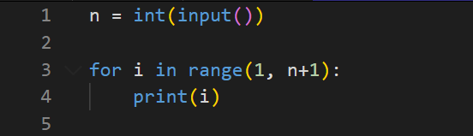
Solution Example
As you can see, you take in input, perform the required logic, and output what they want.

Slide 9
Where do we Practice?
There are many websites to read problems and submit solutions, where the website runs the code for you, and checks if your output is correct, depending on the various inputs they give to your code.
We will be using DMOJ, basically what all Canadian students use.
Open the website: https://dmoj.ca/
Sign up in the top right corner.
Now you can click the problems section to see a list of problems you can do!
There are also contests hosted on the website too.

Slide 10
Where do we Write Code?
You can use any IDE that you want.
After you are done writing and are ready to submit, just go to the DMOJ problem, press the submit button, copy and paste the code, select the language you used, and submit it.
My recommendation is:
https://ide.usaco.guide/ for Python 3, Java, C++
or https://www.onlinegdb.com/ for more languages.
I recommend your IDE having a text file for input and a text file for output, instead of a console format, since it usually makes your life easier for most problems.

Slide 11
Lacking Motivation?
Competition will motivate you a lot! Kind of like trying to win in any PvP game (like CoD, LoL, or Val—never played any of those lol).
Remember to compete with your friends and classmates, like who has the higher point count on DMOJ :0 (more problems you solve, and the harder the problems are, give you higher points, some contests are rated, giving you elo/rating too).
You can also make and compete with online friends too, by joining the DMOJ discord server. https://dmoj.ca/about/discord/

Slide 12
^.^
Practice (wow, finally doing something)
This is your homework, and I recommend doing it if you are interested in competitive programming or just want to improve your problem solving skills. Aim for solving them correctly or at least attempting to.

Slide 13
Implementation Practice
Junior (beginner friendly)
Hello, World! - https://dmoj.ca/problem/helloworld
A Plus B - https://dmoj.ca/problem/aplusb
CCC '14 J2 - Vote Count - https://dmoj.ca/problem/ccc14j2
Senior (challenging) (if junior is too easy, or you want more practice)
CCC '14 J1 - Triangle Times - https://dmoj.ca/problem/ccc14j1
CCC '23 J3 - Special Event - https://dmoj.ca/problem/ccc23j3
UACC 1 P2 - Puzzling Parks - https://dmoj.ca/problem/uacc1p2
Get used to DMOJ and the problem solving format. Problems in the homework will always be listed from easiest to hardest (my opinion though, not absolute difficulty). Remember, output has to be in the exact same format required. Also, we will always take up the homework problems (unless no one wants the solution for that problem), during the next competitive programing presentation.

Slide 14
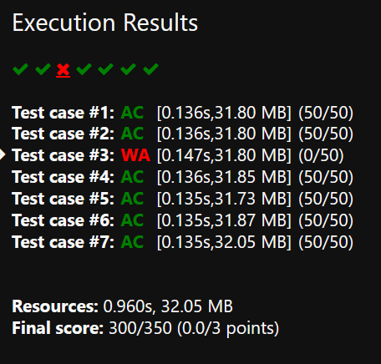
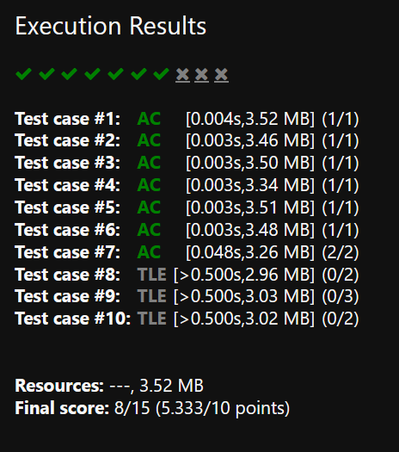
Common Errors
https://dmoj.ca/about/codes/
AC: Your program passed testing! You solved the problem correctly.
Other errors:
Probably just means your program crashed.
Read the error message for more information.
Sometimes you might get presentation error, meaning the way you are outputting is wrong. (eg. you have trailing whitespace).
WA: Your program did not crash while executing, but the output it produced was wrong.
TLE: Your program went above the problem’s time limit.
MLE: Your program went above the problem’s memory limit.

Slide 15
Thanks!
Do you have any questions?
Jason Sun - 350702866@gapps.yrdsb.ca
Puneet Bhat - 349068395@gapps.yrdsb.ca

